Slide 1
SIGNATURE VERIFICATION
PDPM IIITDM JABALPUR
UNDER THE GUIDANCE OF DR. PREETI KHANNA
GROUP MEMBERS
PRAKASH PRAJAPAT | 2018350
AMINESH KUMAR RAI | 2018314
SYEDA MUSKAN SARA | 2018382

Slide 2
Introduction
Even in today's age signature is the most important and most used form of proof of identity of a person. Signatures are used for all documents in financial services, legal services or on letters, documents, checks, security documents.
Thus to reduce illegal acts like forgery is a great concern in our day and age.
Negligence of signature verification is one of the main cause of fraud in our country.

Slide 3
Methodology
Pre-Processing
Feature Extraction
Verification using Extracted Features

Slide 4
Pre-Processing
The Steps of Pre-Processing of the image from database is :
Conversion of Colour Image to Gray scale
Filtering of image for denoising
Binarization of Grey scale image
Thinning
Shifting towards the origin
Skew Correction
Cropping

Slide 5
Feature Extraction
The following features are extracted from the processed image:
Normalised Signature Area -
Total number of black signature pixels divided by total number of pixels of the image
Aspect Ratio -
The Aspect ratio of the processed image = width/height
Maximum Horizontal Projection -
It is the maximum number of black pixels among all horizontal rows of the image

Slide 6
Feature Extraction
The following features are extracted from the processed image: (continued)
End Points -
It is the number of endpoints of the signature.
Centroid of vertically divided images -
It is the pair of centroid of the 2 images formed by vertically dividing the main image.
Slope -
It is a slope of line joining CGs of the first and second halves of the signature image.

Slide 7
Verification using Extracted Features And Further Improvements
Once the Features are extracted they are stored in a Vector. Now we need to fix minimum error threshold values for each feature implemented using which it classifies genuine signatures.
We have done this step manually by selecting error threshold values.
Making a machine learning, neural network and training it to generate more accurate error threshold values that can improve the accuracy of the program.

Slide 8
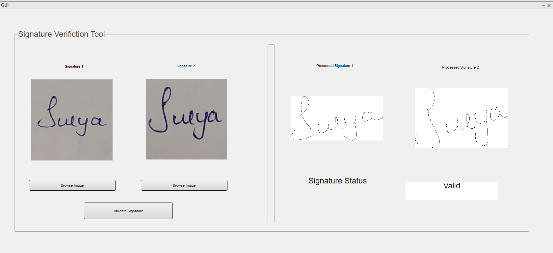
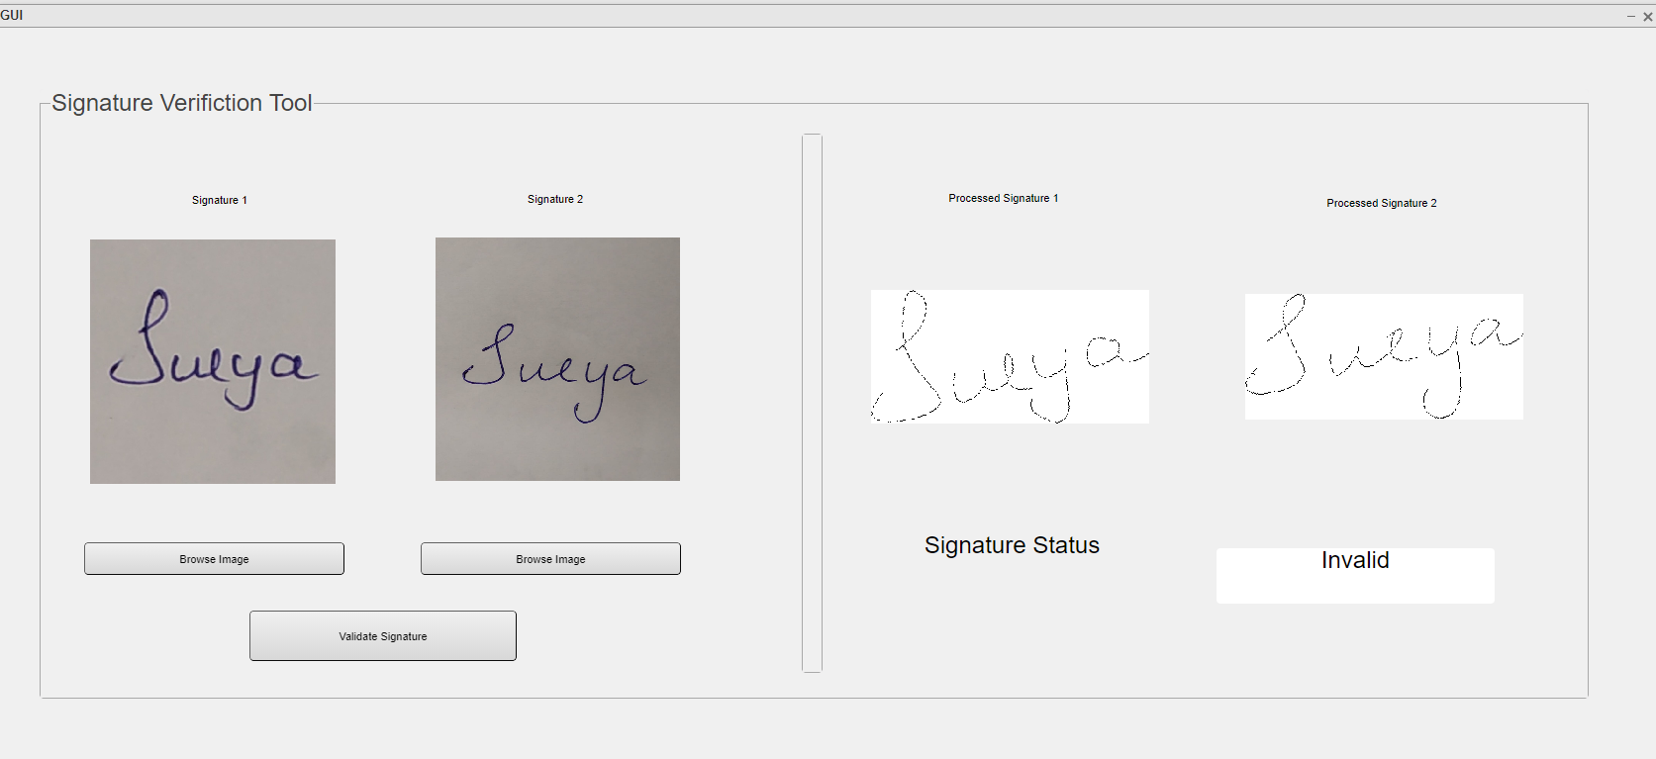
Results
We have written a program in MATLAB that identifies and distinguishes between genuine and forged signatures with a good accuracy.
Screenshots of working GUI:

Slide 9
THANK YOU

